Slide 1
Project: MS 7330 File Organization and Database Management
Paritosh Rai
ID: 47998747

Slide 2

Agenda
Data Requirements
ER Diagram/ Model
Mapping
DDL Statement: Create Table
Insert Data Into Table
Complex Queries
Business Functionality
Audit Trigger
Conclusion

Slide 3

Data Requirements
Build a Database for a New Tier1 Cell Phone operator in the US, planning to build 100,000 sites to cover the country's full geography. This database will be used for:
Monitoring and Tracking Project Progress
Identifying Site Details
Managing spend and budget
Reporting status to Top Management
Vendor Management
Three key areas were identified:
Cell_Site (Site): Containing site details like id, name, address
NSB: Tracking dates of the Milestones
Vendor: Vendor information, address, SoW, cost etc.

Slide 4

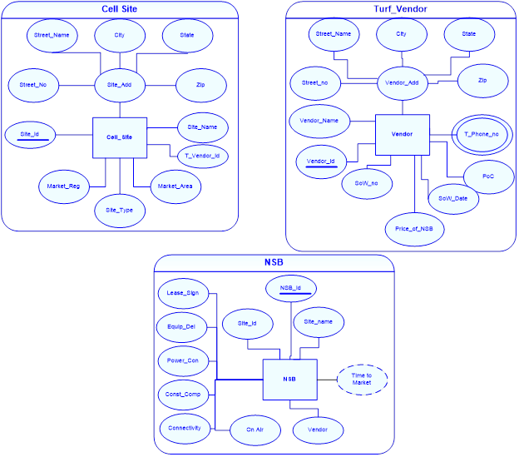
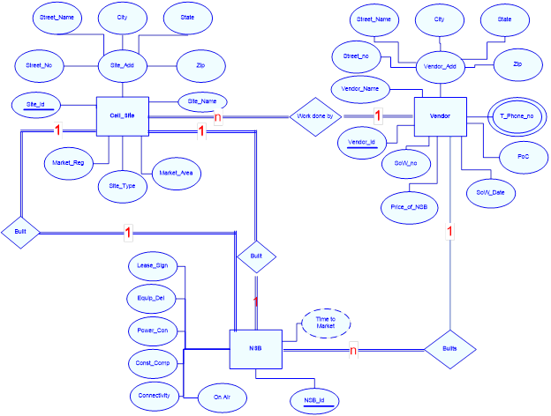
ER Diagram/ Model
1. Identify Entities
2. Identify Attributes of Entities
3. Relaltionship Identification
5. Cadinality Ratio
Create ERD
4. Degree of Relationship
After discussion with the Project Management team, SMEs and looking at data requirement Entity Relation(ER) Diagram was created to ensure end-user requirements were interpreted and captured correctly:
Three Key Entities were Created
Attributes were identified
Relationship among Entity is captured

Slide 5
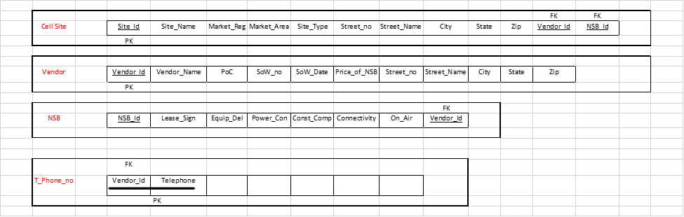
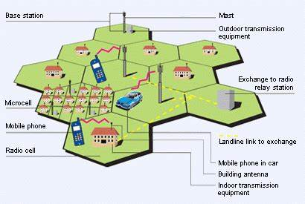
Mapping
The six-Step process was followed:
Step1: List Entities with Attributes and identify PK(Primary Key)
Step 2: No week Entity was identified
Step 3: Multi-value Attribute Telephone as added as a table to Schema.
Step 4: No m:n (many to many relations was identified).
Step 5: Add FK (Foreign Key) to capture 1:n (one to many relations).
Step 6: Added FK for 1:1 relation was added. The relation between the cell Site(Site) table and NSB was identified as total and recursive.

Slide 6

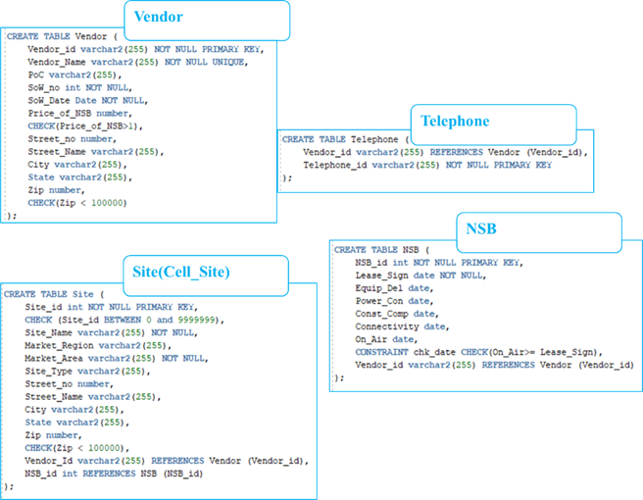
DDL Statement: Create Tables
Vendor
Telephone
NSB
Site (Cell_Site)
Four Tables were Created
Constrains were defined in the table
Constrain | Description
Not NULL | This constrain ensures column cannot store NULL Value
UNIQUE | Ensure each row of the column must have different values
Primary Key | This constrain is combination of NOT NULL and UNIQUE. This constrain ensures unique identifier.
Foreign Key | This ensure referential integrity of the data
Between | Ensure value entered stay between specified values
Date Check | This constrain ensure activities are happening in logical order in time domain
Numeric Value | Ensue value is less than, greater than or equal to certain specified value.

Slide 7

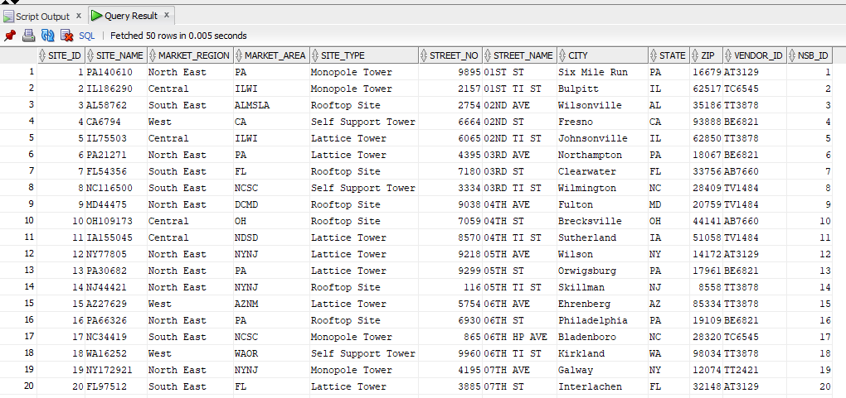
Inserting Data into Table
Sample screen Short from Oracle SQL Developer
Data Base
Data base of 100,000 tuples was created with multiple columns
Data Collection
Raw Data was collected in excel to ensure all the concern parties are easily able to populate the information
Insert to SQL
Excel was leveraged to create the script to insert the data into SQL to respective tables

Slide 8
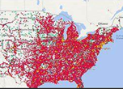
Five (5) Complex Quires
Following Five Quires were created to report update on NSB built to the leadership
Number of sites on Air by Jun 06th by Market Area
Number of sites on Air by Jun 06th by Vendor
Region planed for Maximum number of sites
Percentage sites on Air per Market Area as of Jun 06
Calculate Amount due per vendor based on site on Air by Jun 06th

Slide 9

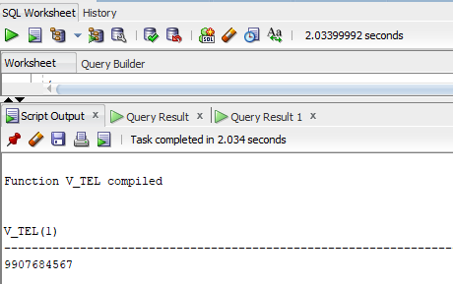
Creation of Business Functionality
Based on the feedback from the project team, business functionality was built to support them in managing their vendor.
Function was built to pull the phone number of vendor managing the site.
This function saves a lot of time for the Project Manger to avoid culling through data to find the contact number of vendor

Slide 10

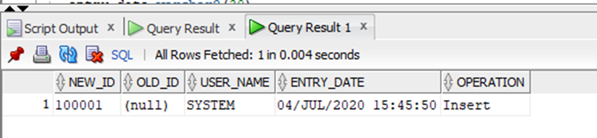
DB Audit Trigger
Audit Trigger
Delete
Add
Updating
To manage and track the changes in the program Audit Report was triggered that can capture the information about:
Change location(site)
Date and Time
Owner

Slide 11
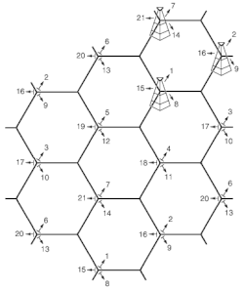
Conclusion
Database building modifying is an ongoing phenomenon. Like leaving creature, it always requires feeding and caring. Following are Next Steps:
Team will continue to work with stakeholders
Set up regular cadence with front end user get firsthand feedback to enhance and improve the data.
Continue working on new functions to enhance and ease off the job from frontline workers
Work with the leadership team ensure data is readily available to them for reporting and tracking progress.
THANK YOU!

